Slide 1

Data Science @ GT
Data Science with a focus on the community
Notes:
**lucy: just needed to add elections slides!!!! didn’t really change much else from 3/14 slides

Slide 2
What are workshops?
Meetings held weekly
Teaching: Data Sci and ML topics
Balancing: Theory and practicality
Emphasizing: Real world skills for real world applications
Promoting: Interactive learning with hybrid lecture/coding
Featuring: Guest lectures. Hackalytics

Slide 3


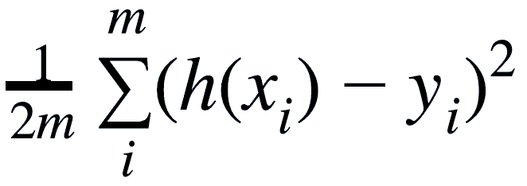
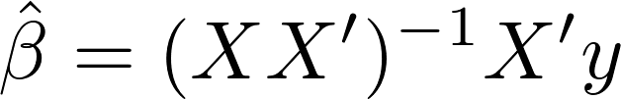
Goals: Where We Stand
User Level
Available toolkits.
Plug & chug coding
Master Level
Einstein-level math.
Formulations

Slide 4
Goals: Where We Stand
User Level
Available toolkits.
Plug & chug coding
OUR GOAL: Develop a deep understanding of data and analytical/predictive models while using tools widely used in industry
Us
Master Level
Einstein-level math.
Formulations

Slide 5
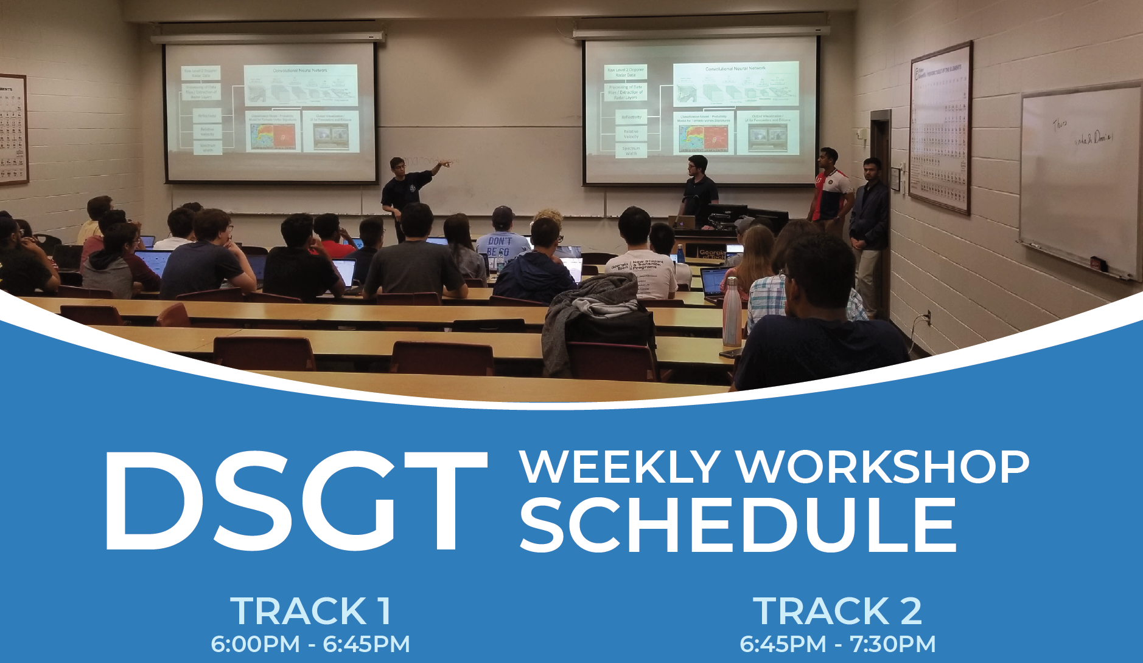


Slide 6
Format
Hybrid format
1) Lecture
2) Coding
Focus on interactivity
For the love of all things…
Ask questions!!!!

Slide 7
Path to Checkpoint
For new members:
Attend 1st four lectures
Certification exam
Take home
Multiple choice
Open note
Open internet
Required to join project team

Slide 8
Schedule
Track 1
Intro to DS
Programming for DS
Mathematical Principles for DS
Survey of Algorithms for DS
Classification
Regression
Guest Lecture: Academia
Clustering
Dimensionality Reduction
Statistics for DS
Track 2
Fundamental Understandings of Models and Data
Time Series: Autoregressive Models
Intro to NLP
SVMs/Autoencoders
Random Forests & Decision Trees
Advanced Clustering
Guest Speaker: Academia
Generative Models
Ensemble Methods

Slide 9




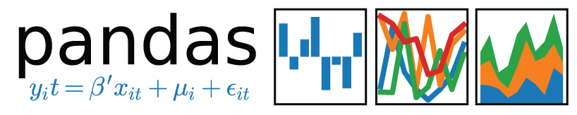

Tools
Tools:
Scikit learn
Python
Jupyter notebooks
Pandas
Numpy
Matplotlib
Seaborn
Tableau

Slide 10

Questions/Comments?

